Slide 1
Linear Discriminant Analysis
Group Number : 5
AU1741036 - Ratnam Parikh
AU1741042 - Manav Shah
AU1741074 - Arpitkumar Patel
AU1741051 - Jainam Ajmera
AU1741092 - Hardi Trivedi

Slide 2
Introduction
Definition : Linear Discriminant Analysis (LDA) is most commonly used as dimensionality reduction technique in the pre-processing step for pattern-classification and machine learning applications.
Objective : The objective of the LDA is to project the original data matrix onto lower dimensional space.

Slide 3
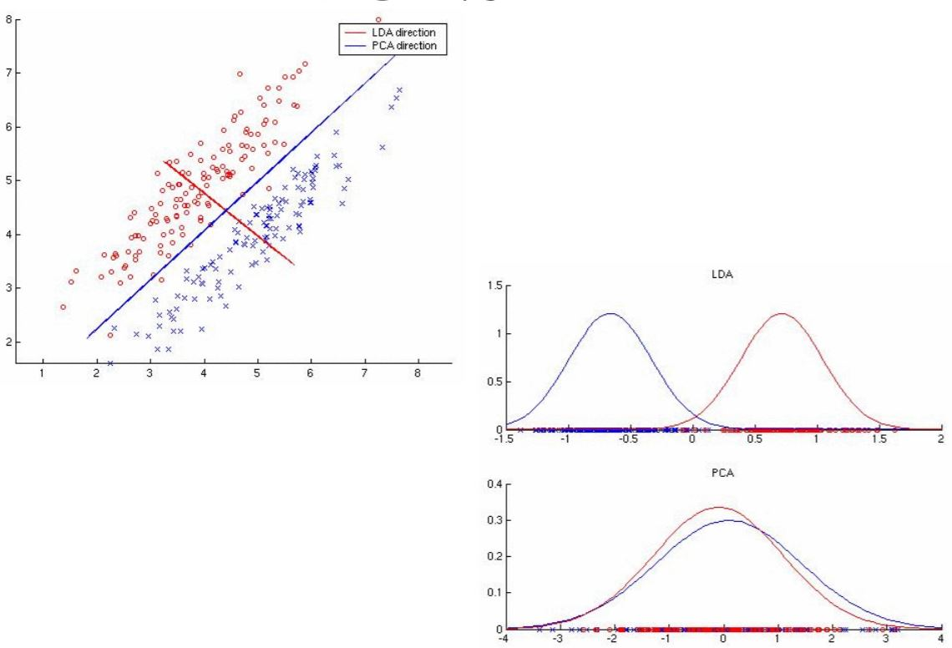
Introduction

Slide 4

Existing Approaches
We have considered a binary 32x32 image which consists of at most two pixel values for the color black(0) and white(1).
Accordingly, there are two classes one with value 0(black) and other with value 1(white).
We have divided our approach to LDA in three parts :
To calculate the sepratibility between different classes, which is known as within-class variance.(Sw)
To calculate the distance between mean and samples of each class, which is called between-class variance.(S_{B})
To calculate eigenvalue and eigenvectors of

Slide 5
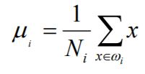
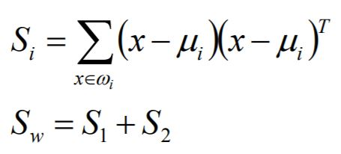
Existing Approaches
Calculating Within-Class Variance:

Slide 6
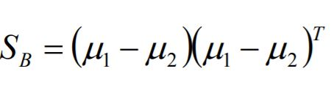


Existing Approaches
2. Calculating Between-Class Variance:
3. Calculating Eigenvalues And Eigenvectors:

Slide 7
Results
EigenValues Project | EigenValues In-Built
EigenVectors Project | EigenVectors In-Built

Slide 8
References

